Slide 1

Company Presentation I October 2018

Slide 2

YOUR SPECIALIST FOR INDIVIDUAL SOLUTIONS
“As a third-generation family business, we appreciate the value of more than 80 years of experience that we can rely on. Building on this wealth of experience, we understand the importance of continuous development.
This makes Teckentrup a real solution provider for our customers and partners. We no longer sell 'just’ products, but needs-based solutions.
Services with a real added value for our partners."
Kai Teckentrup – OWNER & Chief Executive officer

Slide 3
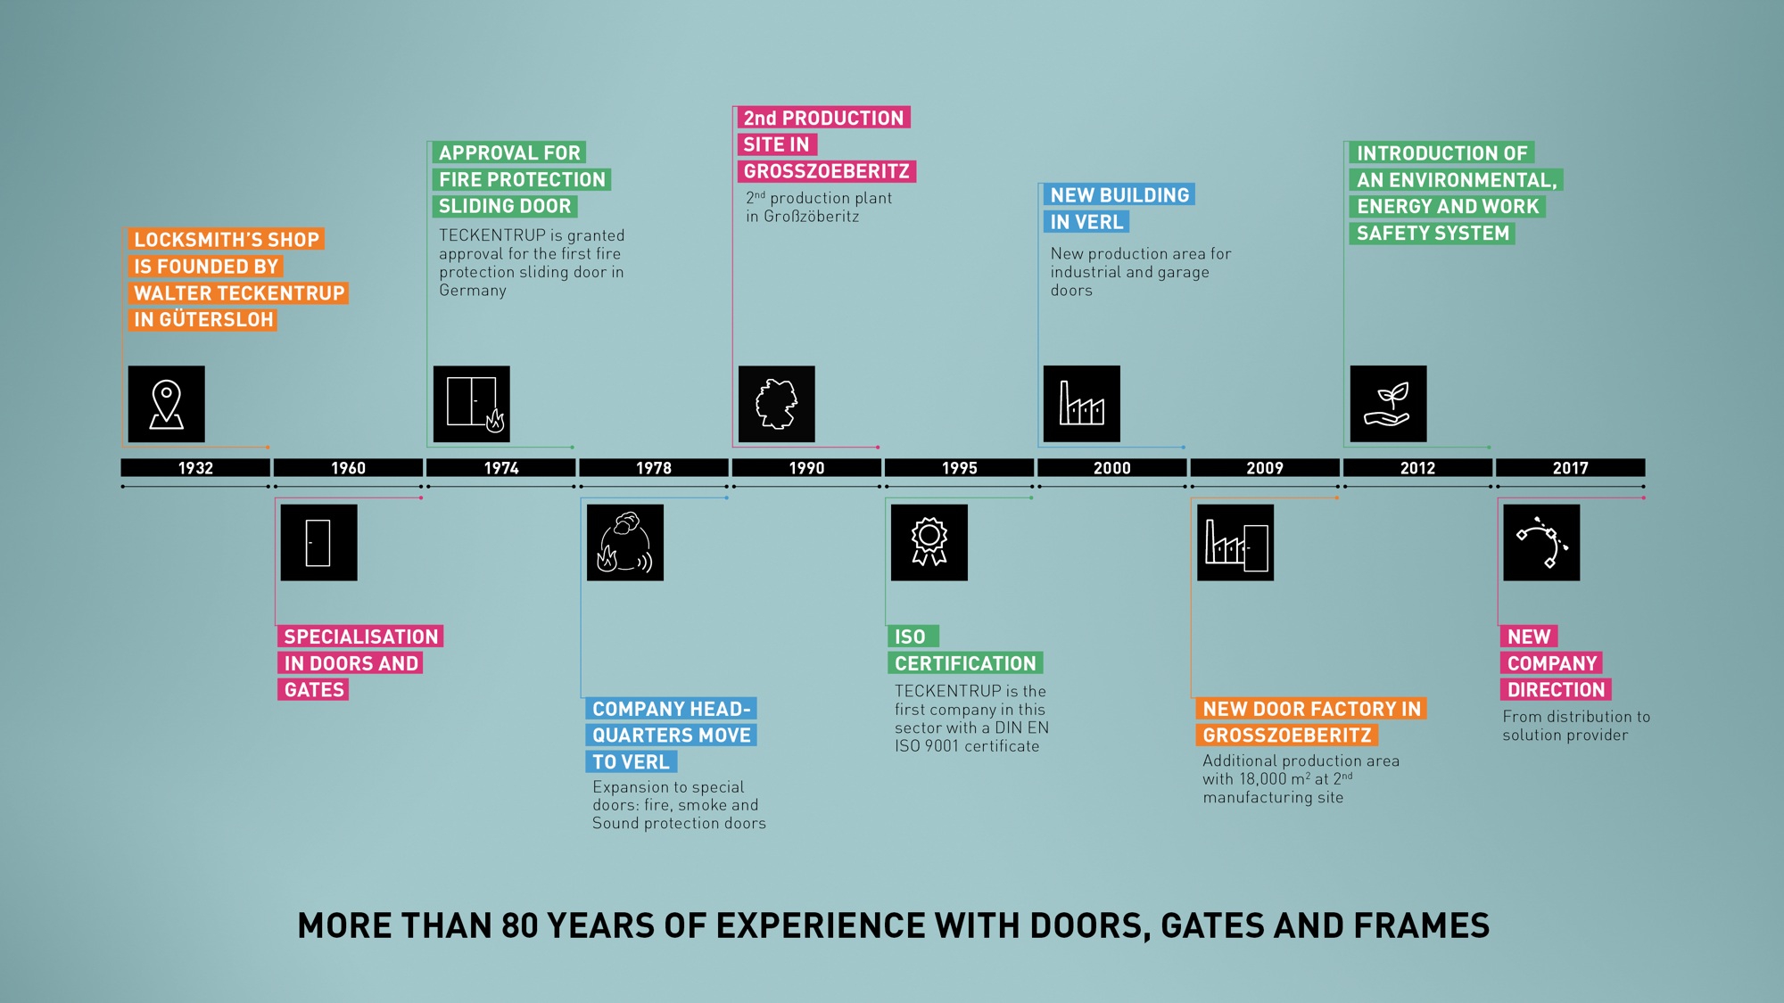
BECOMING ONE OF THE MARKET LEADERS IN EUROPE

Slide 4
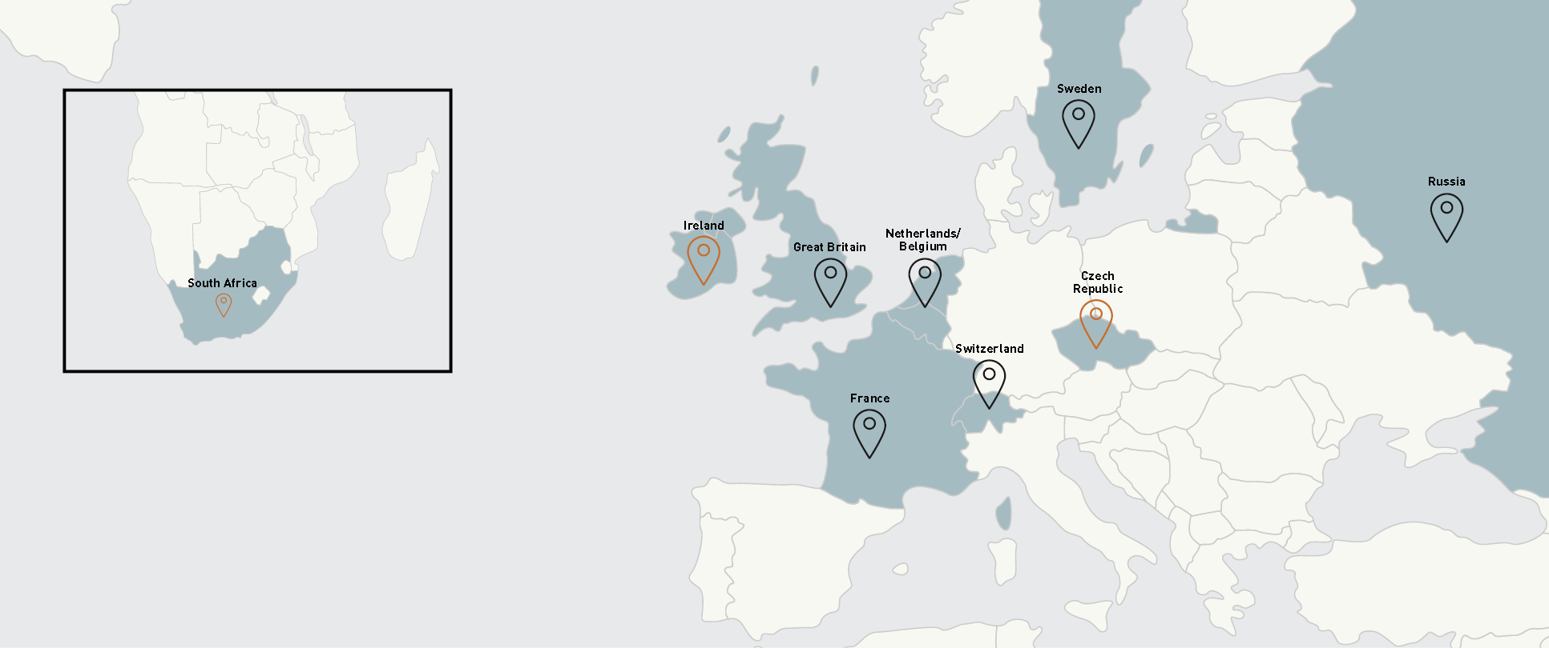
TECKENTRUP INTERNATIONAL
6 local offices in France, the United Kingdom,
the Netherlands / Belgium, Russia, Sweden and Switzerland.
Sales representatives in Ireland, South Africa and the Czech Republic
WE HAVE customers all around THE WORLD
In more than 40 countries

Slide 5


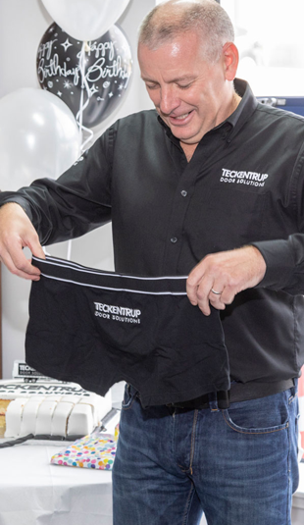

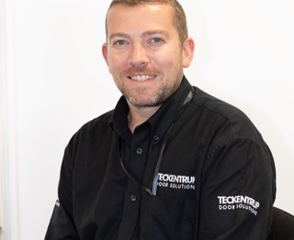
Working with you to develop solutions.

Slide 6
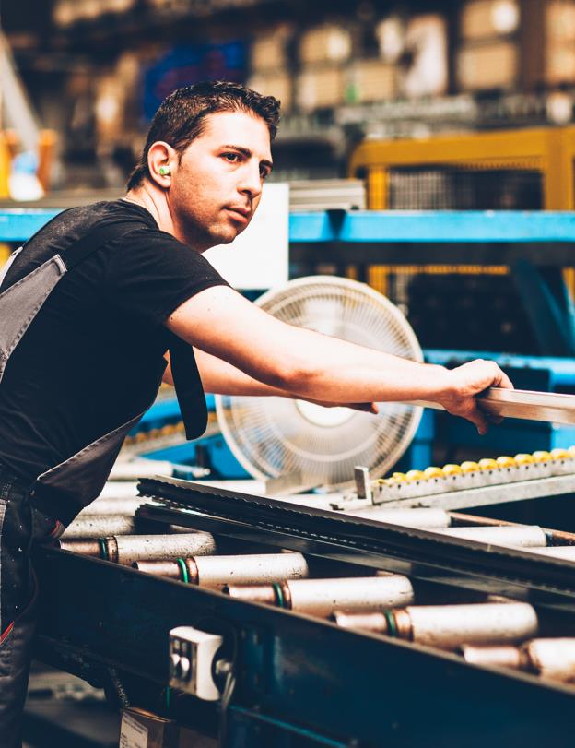

TECKENTRUP QUALITY
Certified competence
Our products and internal operating processes meet
the highest standards for quality, environment and
safety and are continuously refined.
Quality management in accordance with DIN EN ISO 9001
Environmental management system in accordance with DIN EN ISO 14001
Energy management system in accordance with DIN EN ISO 50001
Occupational health & safety protection in accordance with BS OHSAS 18001
Environmental Product Declaration in accordance with ISO 14025 + EN 15804

Slide 7
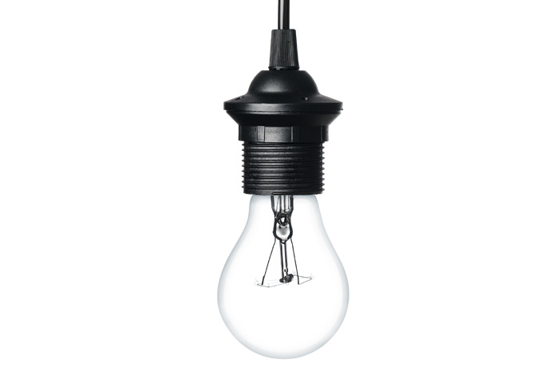

TOGETHER INTO A
SUCCESSFUL FUTURE
What are the current market demands?
What do you expect from doors and gates?
Where can we improve, both in terms of products as well as services?
We have integrated a co-creation process into our everyday activities to develop
new ideas in collaboration with you and find innovative solutions as well as responses
to these and many other issues. Whatever we do, the underlying question for us is:
WHAT IS THE BEST SOLUTION FOR YOU?
DESIGN I SICHERHEIT I SERVICE

Slide 8

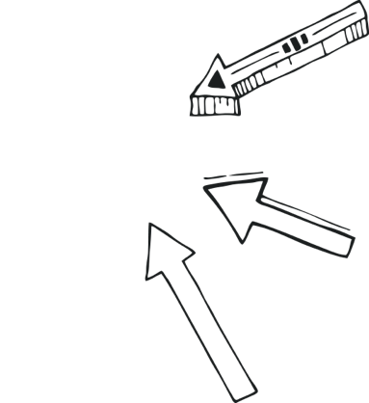
ACHIEVING MORE TOGETHER:
CUSTOMER CO-CREATION
The success of innovative product ideas and services…
→ …is reflected in jointly developed and clearly defined benefits
→ …is always confirmed in a large-scale field test that we invest in
→ …is reviewed and further developed with you and your networks
Creating knowledge
PROTOTYPE
PRODUCT
This results in product solutions that meet your demands and service offers up to the point of market readiness
Build
Feedback
DESIGN I SECURITY I SERVICE

Slide 9
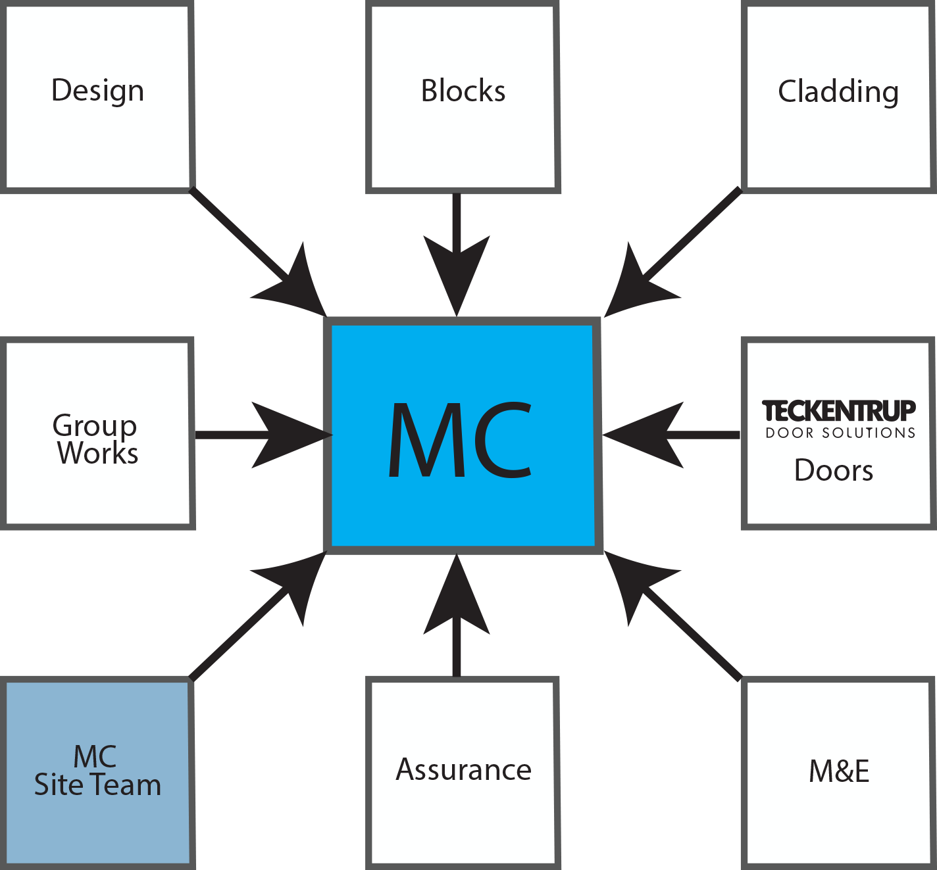
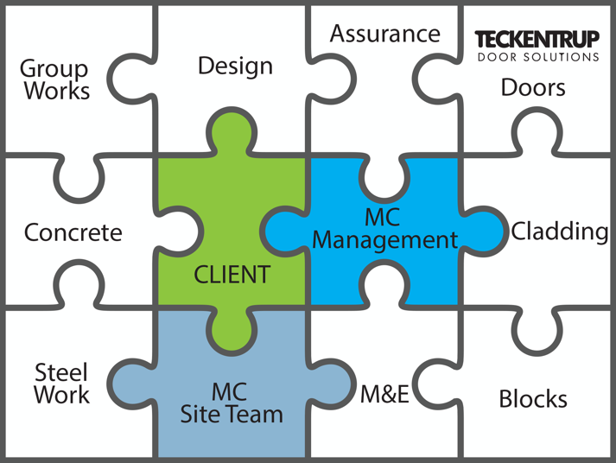

PROJECT

Slide 10



THREE STANDARDS FOR A
MORE UNIQUE CHARACTER
DESIGN | We link functionality and aesthetics.
Because good design represents innovative technology that meets users' needs.
Our products unveil new worlds and offer many individual design options. Our philosophy is based on designers and engineers working hand in hand from the outset. Consequently, we guarantee that intelligent ideas are also conclusive at a second glance and challenging design stands the test of time.
SECURITY | We link systems to protection.
Our doors meet the highest standards and have been certified accordingly. They protect from threats including fire, smoke, sound and burglaries. We will take the
time to discuss required standards and develop comprehensive security concepts
to protect people and valuable items as required.
SERVICE | We link speed to reliability.
Proximity, clear structures, everything from a single source. This is the service advantage Teckentrup delivers. From product development to installation, from committed support by our specialist consultants, to professional maintenance:
we will be there for you right away. And we are happy to take the time you need.
ALL FROM
ONE SOURCE
PROFESSIONAL (Doors)
INDUSTRIAL (Industrial doors)
HOME (Garage doors)

Slide 11
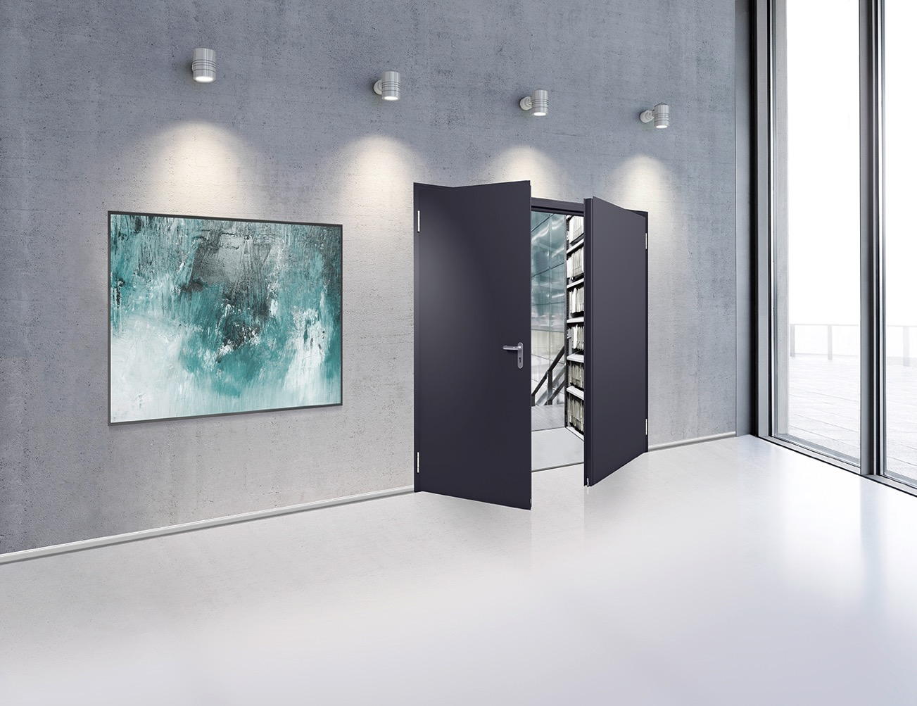






Teckentrup | PROFESSIONAL
PROFESSIONAL
    Fire protection doors
    Smoke protection doors
    Security doors
    Sound-insulating doors
    Multi-purpose doors
Fire protection sliding door
DOOR SOLUTIONS FOR MORE
SECURITY AND PERFORMANCE

Slide 12
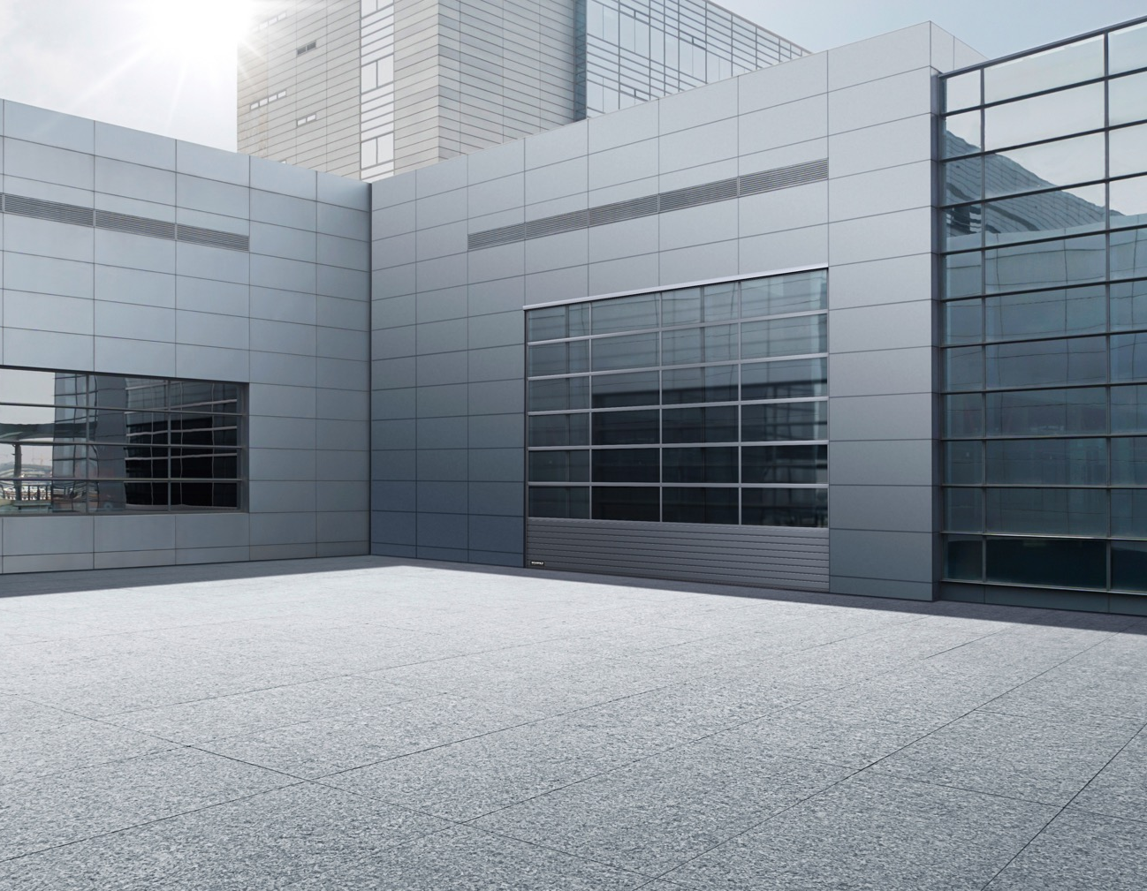





Teckentrup | Industrial
INDUSTRIAL
    Industrial sectional doors
    Industrial roller shutters
    High-speed door
    Folding door
    Fire protection sliding doors
RELIABLE INDUSTRIAL DOORS THAT
KEEP YOUR BUSINESS RUNNING

Slide 13


Teckentrup | HOME
HOME
    CarTeck sectional doors
    CarTeck up-and-over doors
    CarTeck drives
    CarTeck side doors
SMART GARAGE DOORS:
CONVENIENT, SECURE AND ATTRACTIVE

Slide 14

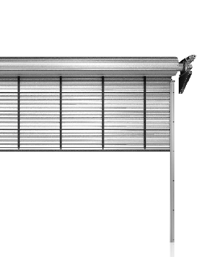
MORE SAFETY, MORE SPEED.
Industrial | ThermoTeck high-speed roller shutter
starting Q3
Fast:
Speed of operation up to 1.5 m/s (USP)
Quiet and efficient:
Quiet operation and extremely low wear and tear due to a patented strap system (USP), optimised for security
Weather proof:
Can also be used outside, wind load up to windload class 4 (USP)
Safer:
Inner light barrier that is effectively protected from elements and vandalism, no additional light barrier needed
Huge:
Door sizes up to max. 10 m width and max. 9 m height

Slide 15
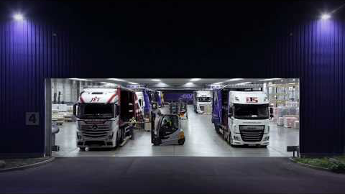

Slide 16

Teckentrup | SERVICE
Teckentrup | Service
360°
DESIGN I SICHERHEIT I SERVICE
DESIGN I SECURITY I SERVICE

Slide 17
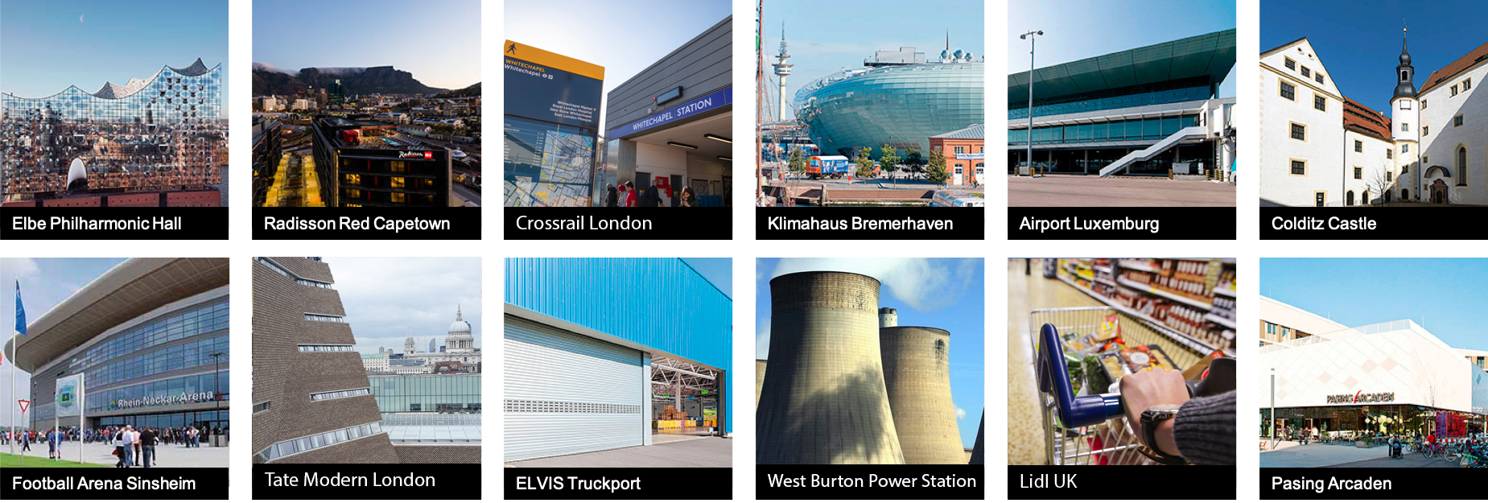
WHERE OUR DOORS AND GATES ARE AT HOME.
Teckentrup in operation.
Satisfied customers are the best references. And we have plenty of those.
From Elbe Philharmonic Hall and Radisson Red Cape Town hotel to Klimahaus Bremerhaven scientific
exhibition site – our doors are everywhere. See for yourself and let us convince you!
Case studies:
www.teckentrup.co.uk/
company/case-studies

Slide 18

THE TECKENTRUP PROMISE:
We find the best solution: The solution for you.
Whether in development, production
or sales, whether it’s about the overall
concept or a small detail – for us the
key question is always:
WHAT IS THE
SOLUTION FOR YOU?
DESIGN I SECURITY I SERVICE

Slide 19
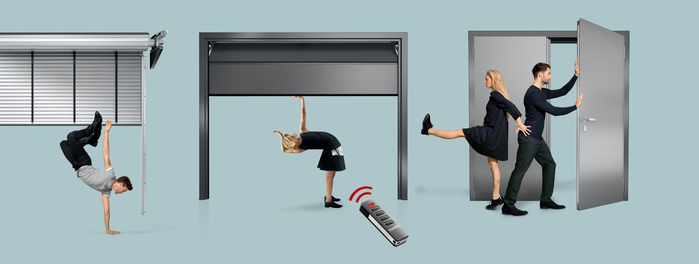

Understanding fire doors
October 2019
Teckentrup UK Limited
Teckentrup Door Solutions

Slide 20

Understanding fire doors, the applicable standards and their use in Building Regulations & Construction Products Regulation
What are the key topics?
What are the standards?
Are they comparable
What do they mean in the real world – Building Regulations?
CE marking
Grenfell
Door and frame or a door set
Assessments
E & EI
In covering these topics we are answering this question:
“I must mitigate risk, how can I be sure the fire doors I specify are compliant & am I following best practice?”
Notes:
Summary pages – the key points covered and the overarching objective of the presentation

Slide 21

Expert?
Knowledge
Know where to go for guidance and advice…
Making simple things complex

Slide 22
Why so many standards?
BS EN 13501-1
Manufacturers would agree with this question
But before we talk about fire, lets talk about what we, as manufacturers, prefer and why
We like volumes or at least a forecastable demand
As a European Manufacturer we like CE marking – though its not without its headaches
But why?
BS EN 13501-2
BS 476-22
BS EN 1634-1
BS EN 1634-2
BS EN 1634-3
CERTIFIRE
DIN 4102

Slide 23


How many standards?
EU
28 national…
Regional?
Impossible to produce efficiently

Slide 24

HENS
Harmonise
Harmonise standards across all states
Standards were prescriptive – “make things this way”
Now, manufacturers can make things how they wish but must report the characteristics within a common framework that:
Facilitates fair comparison
Facilitates informed choice
Maintains commercial imperative

Slide 25
The answer why we like this is volume
But not just Fire…
Security
Acoustics
Pressure
Open and closing
All of these tests and reports are recognised across all 28 states
Volume = efficiency = low costs
Let’s follow the CE Mark Trail and then Compare…

Slide 26
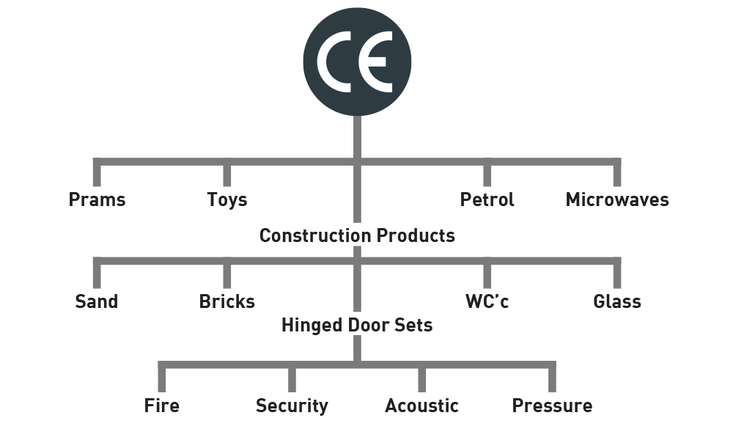
CE
NO!

Slide 27
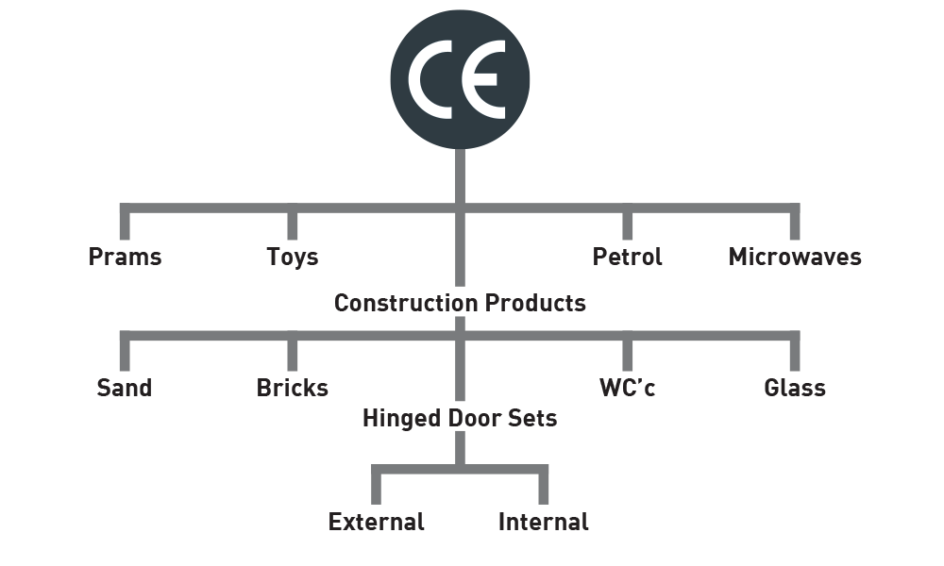
CE

Slide 28
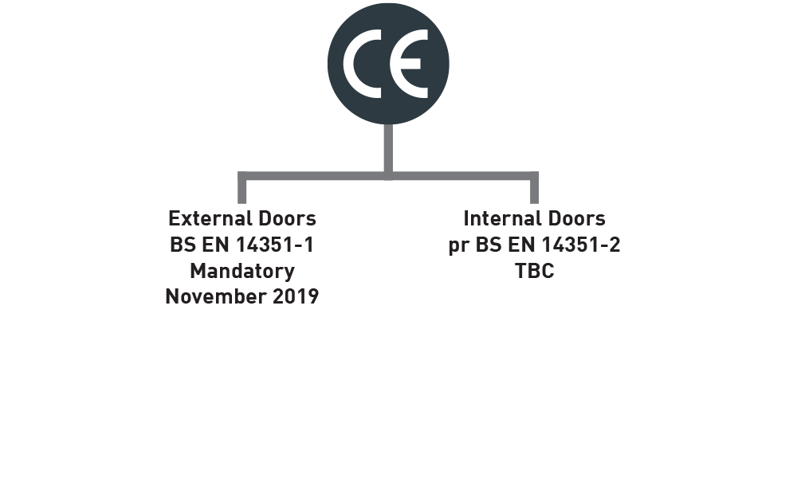
CE Marking Hinged Door Sets

Slide 29
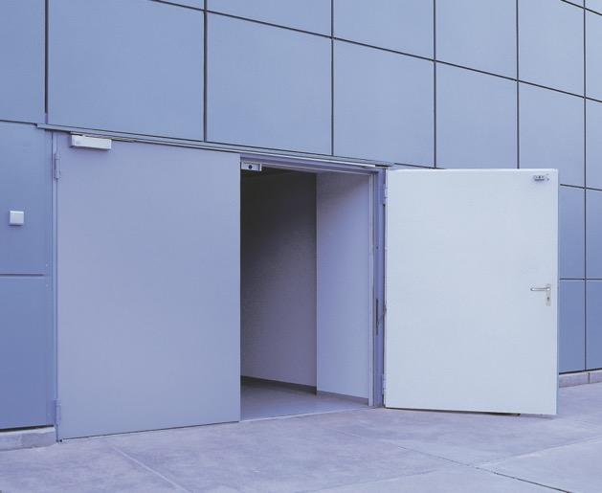
BS EN 14351-1
What do you expect from an external door?
Answer: Keep the outside out and tell you, the user, how it performs.
Essential Characteristics that must be reported:
Resistance to wind load BS EN 12211:2016
Thermal Transmittance BS EN ISO 10077-1
Air Permeability BS EN 12207
Water tightness BS EN 12208

Slide 30


Sub Norms - the option - the door builder
But I want my door to also be a security door with a fire rating
Product performance Sub-norms cover this
For Security and Fire:
Security BS EN EN1627
Fire BS EN EN16034
Pressure
Bullet Resistant
Acoustics
EMC/EMI
Blast
And it goes on………..
A-ha - fire! Remember this number

Slide 31
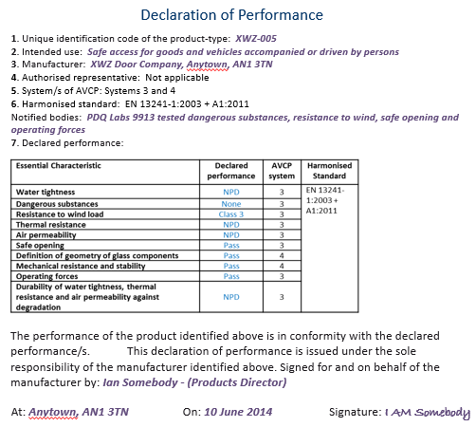
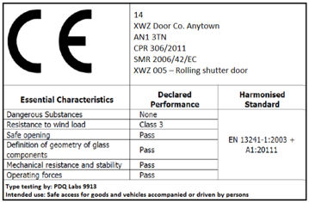
Sub Norms - the option - the door builder
NEED A DoP

Slide 32
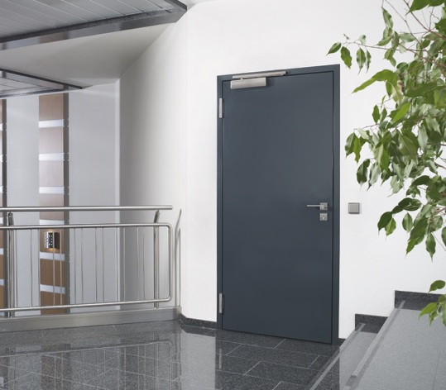
pr BS EN 14351-2
What do you expect from an internal door?
Answer: Keep things compartmentalised and tell you, the user, how it performs.
Essential Characteristics that must be reported for a fire door:
Resistance to fire BS EN 1634-1
Smoke control BS EN 1634-3
Ability to release BS EN 1634-1 / EN 1634-3
Self closing BS EN 1191
Durability of ability to release BS EN 1155 / EN 14637
Durability of self-closing BS EN 1191

Slide 33
Sub Norms - the option - the door builder
But I want my internal door to also be a security door with a fire rating
Product performance Sub-norms cover this
For Security and Fire:
Security BS EN EN1627
Fire BS EN EN16034
Pressure
Bullet Resistant
Acoustics
EMC/EMI
Blast
And it goes on………..
A-ha – fire again ! Same number

Slide 34
Sub Norms - the option - the door builder
NEED A DoP

Slide 35
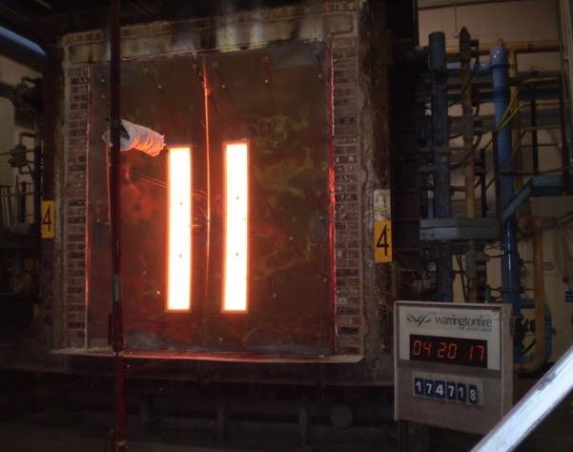
Fire Standards
So we have our internal and external doors and our fire standard? Yes, but …. No…
The three we commonly see are:
EN 1634-1
BS 476 pt22
CERTIFIRE
DIN4102
Essentially these standards all have:
A test
A method of reporting
A method of assessing

Slide 36
The Test
Each test has defined criteria to make them the same…Yes, but …. No…
Each test is different from the other:
EN 1634-1
BS 476 pt22
CERTIFIRE
DIN4102
Can I assume a BS 476 pt22 door is also EN 1634-1?
NO!

Slide 37
The Test
UK: BS 476 pt22
NO!
BS EN 1634
D: DIN 4102
UK: BS 476 pt22
YES!
BS EN 1634
D: DIN 4102
Will Warringtonfire assess
BS EN 1634 to 476 p22 & DIN 4102?
YES!

Slide 38
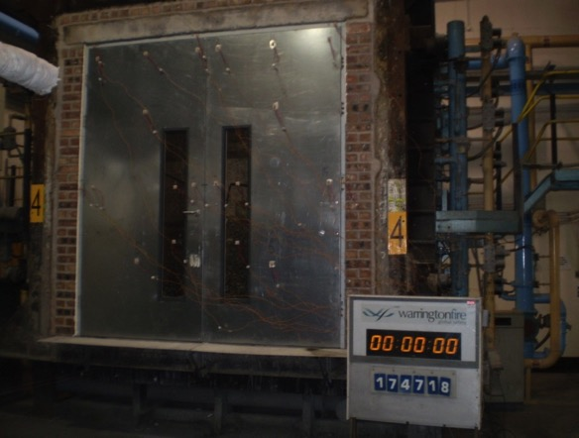
The Test

Slide 39
The Report EN16034
EN16034 goes further:
E Integrity
EI ₂ Integrity & Insulation
EI₁ Integrity & Insulation more onerous
EW Integrity & Radiation
IF I report in these I can sell across all EU states.

Slide 40
Two Big Differences
CE Marking and Certifire are very similar and much more current
CE Marking is supposed to replace BS476 pt 22 for doors
Factory Process Controls
Sampling
You cannot assemble on site under CE marking or Certifire
So what does allow on site assembly? That’s easy - Approved Document B our building regulations which, clearly, are not fit for purpose

Slide 41

What else?
So I’ve got my fire door…Yes, but …. No…
Back to CE marking:
Resistance to repeated opening and closing: Test EN 1191 Report EN 1192
  C1
  C2
  C3
  C4
  C5 – 200,000 cycles
  C6
Smoke:
Test EN 1634-3 Report EN 16034
  S_{a}
  S₂₀₀
One other big DIFFERENCE “The Classification Document”

Slide 42
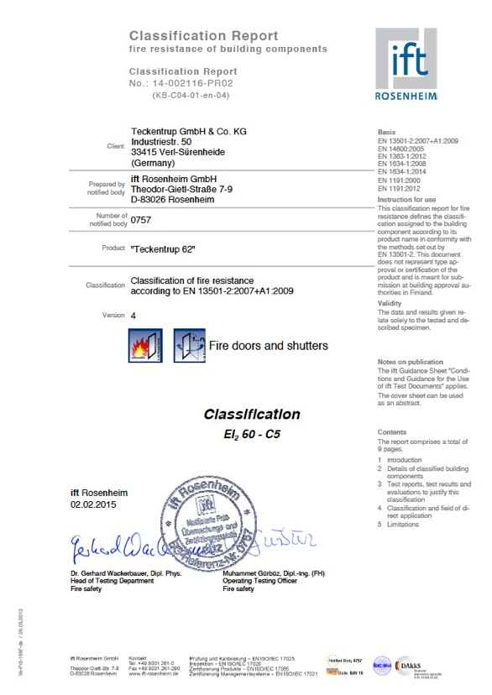
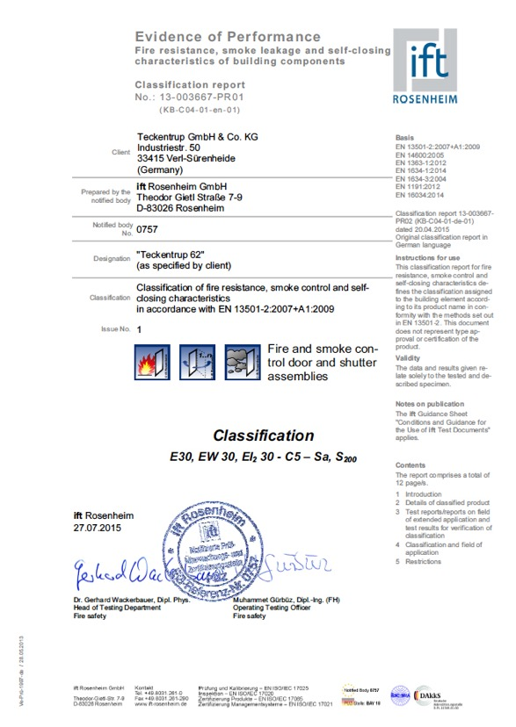
The neat and tidy document EN13501-1
This is where we bring it all together
Fire
Smoke
Opening & Closing (Cyclage)

Slide 43
So let’s go – whoop, whoop!
Well… …Only if you have a need for exactly the door tested…
Tested:
3000mm x 3000mm door
Geze closer
Stainless steel finish
Vision panel
You want
3100mm x 2500mm door
Dorma closer
Steel PPC finish
No vision panel

Slide 44
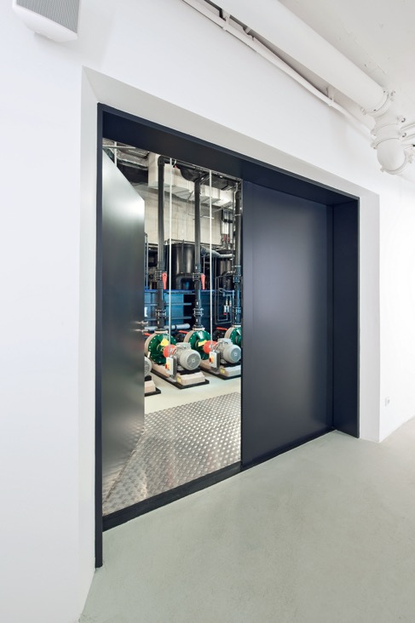
The misunderstood standard EN15269-2
The standard is summarised as …
“Rules for Assessment” or “Extended Applications”
Take our size
3000 x 3000 tested
3100 x 2500 required
Extended Applications says (Paraphrased):
If you test an EI₂60 to EN 1634-1 and over-run by 20% so it passes at 72 minutes
You can then increase:
Height by 15%
Width by 15%
Max 20%
…So we can build your door

Slide 45
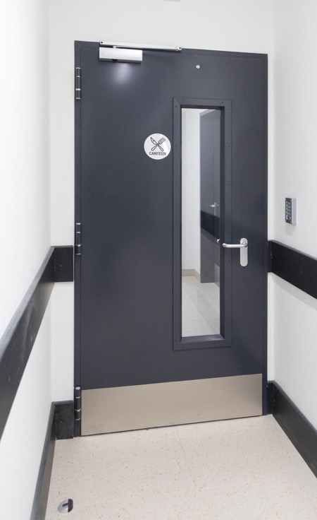
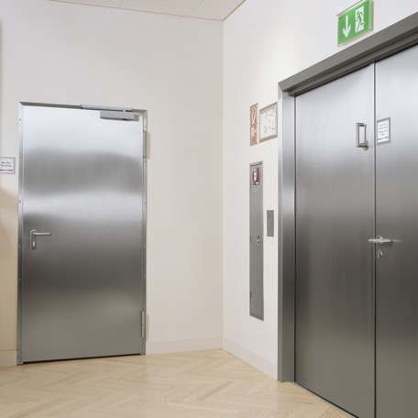
The misunderstood standard EN15269-2
Extended Applications says (Paraphrased):
If you test stainless steel, you can assess down to steel (not up).
Same with glazing - If you test with vision you can remove it but are restricted if you increase the size of the vision panel.
…So we can build your door

Slide 46
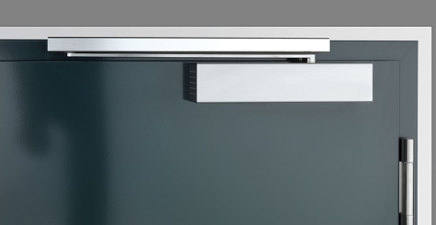
The Curve Ball
Ironmongery
We tested with Geze, you want Dorma
Extended Applications allows either Teckentrup or Dorma to cascade evidence
So, we either test a Dorma closer on our door or ask Dorma for the test evidence for their closer… … simple enough - Yes, but …. No…

Slide 47
Kai I am going to use this cheap ardvaark closer!
I can save £30 a door set …
Their brochure says it is CE Marked to EN1154 and fire rated EI 60 EN1634-1 tested in China…
Will you cascade the info and CE mark it? …Will you Kai? Sven?
No they won't. We have nothing against China – but to believe what is said in a brochure is not good practice. These are life critical products and the penalties for non-compliance are high. Where is the evidence?
There are no third-party accredited test houses in China that can CE mark products – NONE
DHF - statement

Slide 48
Ardvaark
Would you Buy an Ardvaark……..
Car?
Computer
Would you put your child in an ardvaark cot?
What about a TV
Would you buy an Ardvaark fire door?
Why is the answer NO?
Because you don’t know the product and you do not trust the BRAND

Slide 49

Can you trust the Teckentrup BRAND?
Would you Buy a Teckentrup ……..
Car?
Computer
Would you put your child in a Teckentrup cot?
What about a TV
So the answer, trust me, to all the above is No – because we are not experts in any of these things
But can you trust the brand that is Teckentrup for Fire Doors or indeed any Certified product?
Let me convince you…

Slide 50
Why are walls, ceilings and floors EI fire rated
(E = integrity, I = insulation)
Have you ever been asked…
…Yet fire doors are only required to be integrity rated?
…Wouldn't logic suggest fire doors be the same as walls, ceilings and floors?

Slide 51
Why is it that Building Regulations say it’s ok to fit integrity-only fire doors…
…as long as the door does not constitute more than 25% of the surface area of the wall into which it is fitted.
The weakest link?
What does that suggest?
…Replacing EI wall with integrity-only fire doors weakens a building’s fire protection?

Slide 52
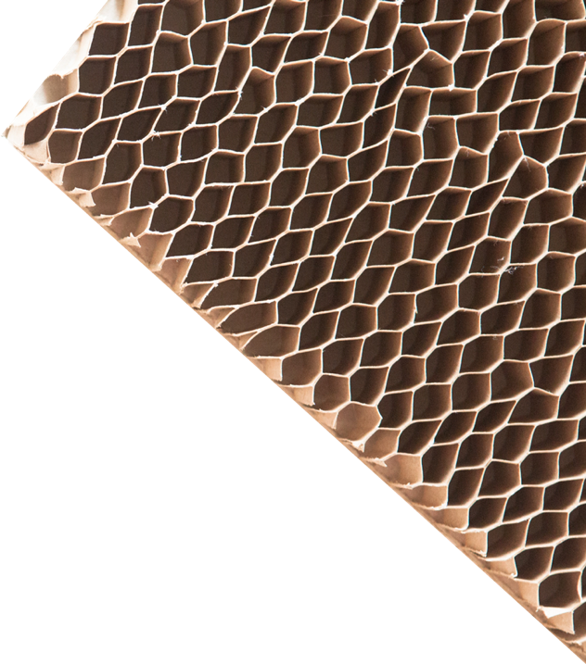
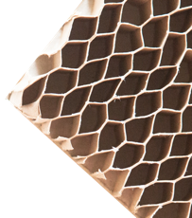
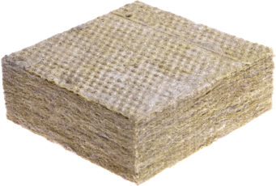

If you looked inside an Integrity-only rated steel fire door what would you expect to see?
What’s inside an integrity-only steel fire door?
Answer: cardboard
…surprised?
Cardboard?
Foam?
Mineral Wool?

Slide 53
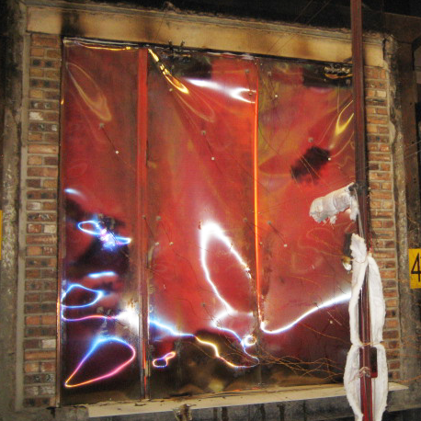
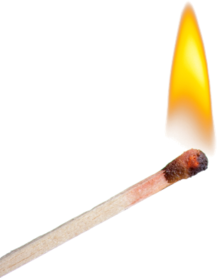
If you watched the test of an integrity-only steel fire door, would you be surprised to learn that a door fails the test if you see a flame the size of a match burning for 10 seconds… probably not…
What makes a fire door fail a test?
However, if the door is glowing red hot at 1000°C and doesn’t flame, the test is passed…
…surprised?

Slide 54

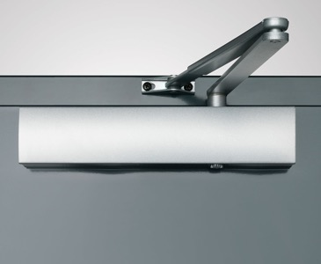
Which side should a door closer be fitted?
The requirement is the non-fire side of a door.
The compliant fire and the exploding door closer…
The non-fire side?
It is intended to be the side on which an escape route may pass or someone “staying put” will be protected from a fire for a defined period – 30 minutes, 60 minutes, etc.

Slide 55

This assumes the route a fire will take through a building is known...
You can plan for this to a degree, however there is no legislating for people putting things where they shouldn’t or fire behaving unexpectedly…
The compliant fire and the exploding door closer…
On an integrity-only door, heat is transmitted straight through the door to the closer.
The closer may flame as the closer’s oil combusts or, worst case, explode, spraying burning oil…

Slide 56
The compliant fire and the exploding door closer…
E Door
If we ask Dorma if we can install a closer where the fire is both sides or the closer is opposite the fire side…
DORMA SAYS NO
We cannot CE mark or issue a CERTIFIRE certificate

Slide 57

Integrity & Insulation rated fire doors are:
Is there a solution?
EI
EI rated, like walls, floors and ceilings.
Do not weaken fire protection.
Contain mineral wool (never, cardboard or foam).
Tested to fail if the non-fire side of the door reaches 180°C.
Safe with a closer fitted to the non-fire side

Slide 58
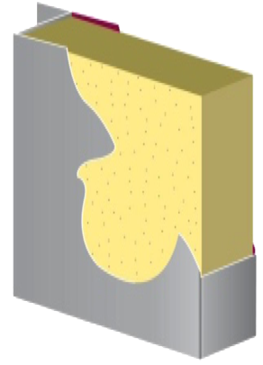
How does a integrity only door compare to an integrity and insulated door during a fire?
E
EI

Slide 59

Radiated Heat: 1.0 m
Heat radiated at 1.0 m from the unexposed side of a steel door in a BS EN1634-1 fire test over time in minutes
35 kW/m2
Significant chance of fatality for people exposed instantaneously
25 kW/m2
Likely fatality for extended exposure, unprotected steel will reach thermal stress temperatures
12.5 kW/m2
Significant chance of fatality for medium duration exposure
>6 kW/m2
Pain within approximately 10 seconds; rapid escape is only possible
0.35
0.57
0.94
1.94
4.46
8.4
14.8
17.3
21.1
27.1
Thermal Radiation Effects: OGP Risk Assessment Data Directory – Vulnerability of Humans

Slide 60
Radiated Heat: 0.5 m
Heat radiated at 0.5 m from the unexposed side of a steel door in a BS EN1634-1 fire test over time in minutes
35 kW/m2
Significant chance of fatality for people exposed instantaneously
33.6
59.2
69.2
84.4
108.4
25 kW/m2
Likely fatality for extended exposure, unprotected steel will reach thermal stress temperatures
Now let’s look at the
Thermal Radiation Effects from 0.5 m
12.5 kW/m2
Significant chance of fatality for medium duration exposure
>6 kW/m2
Pain within approximately 10 seconds; rapid escape is only possible
1.4
2.28
3.76
7.76
17.84
33.6
59.2
69.2
84.4
108.4
Thermal Radiation Effects: OGP Risk Assessment Data Directory – Vulnerability of Humans

Slide 61


How does the UK compare to other countries?
Construction products Regulation Doors
Ext Door BS EN14351-1
Int Door (prov.) BS EN14351-2
Fire Test BS EN1634-1
Standard BS EN16034
E Integrity
EI1 Integrity and Insulation
EI2 Integrity and Insulation
EW Radiated Heat
EI/EW-rated
E-rated

Slide 62
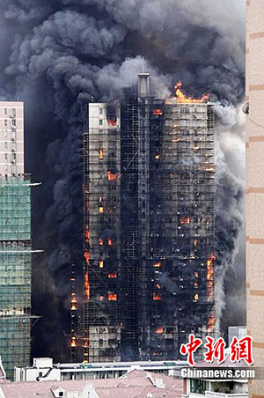
America? – the original source of integrity-only steel fire doors.
Still in use but insulated doors are now required on hallways, corridors, stairwells, lobby’s and escalators.
How does the UK compare to other countries?
Hong Kong? – historically used British standards for obvious reasons, however after the 1996 fire at the Garly Building, Kowloon, which killed 41, Hong Kong now deviates from UK Building Regulations, requiring insulated fire doors.
With high rise buildings more densely packed than almost anywhere else on the planet, Hong Kong high rise building practices are recognised globally as best practice.

Slide 63
EI fire doors are freely available at comparable cost to E-only fire doors.
Time to follow suit?
Construction products Regulation Doors
Ext Door BS EN14351-1
Int Door (prov.) BS EN14351-2
Fire Test BS EN1634-1
Standard BS EN16034
E Integrity
EI1 Integrity and Insulation
EI2 Integrity and Insulation
EW Radiated Heat

Slide 64
The obvious outcome for fire doors is for them to match the environment they are placed in – Insulated walls, floors and ceilings = insulated fire doors

Slide 65

Thank you

